Slide 1

PONG GAMES
(BCSE0352)
Department of Computer Science(CLOUD COMPUTING)
(Submitted To: Dr DIVYA SINGHAL )
Group Members
Name of Member | Roll Number | Role | Department n Section
TAMAN KUMARI | 2401330120199 | Designer | CS, C
TANISHA BHATI | 2401330120200 | Presenter | CS, C
NAVNEET SINGH | 2401330120100 | Documenter | CS, B

Slide 2

Index
Introduction
Literature Survey/Existing System
Problem Statement
Proposed Methodology
Flowcharts and Use Case/ER Diagrams
Feasibility Study
Hardware /Software Requirement
Results and Conclusion
References
Live Demonstration of Project with screenshots in ppt

Slide 3
Introduction
Project Title: Pong Game
Overview:
This project is a simple recreation of the classic Pong game using Java's Swing and AWT libraries. It demonstrates core programming concepts such as GUI design, event handling, animation, and basic AI behavior.
Key Features:
Player Paddle Control: Controlled using UP and DOWN arrow keys.
AI Paddle Movement: Automatically tracks the ball's position.
Ball Physics: Bounces off paddles and screen edges.
Score Tracking: Displays player and AI scores in real-time.
Game Loop: Uses javax.swing.Timer for smooth animation.
Purpose:
To apply Java programming skills in building an interactive GUI-based game, reinforcing concepts like object movement, collision detection, and user input handling.

Slide 4
Literature Survey / Existing System
Pong is one of the first arcade games, created by Atari in 1972.
Many versions exist today: web-based, mobile apps, and game engine-based.
Existing systems often use advanced tools or lack transparency in logic.
This project recreates Pong using pure Java (Swing/AWT) for educational clarity.
Focuses on core programming concepts: GUI, animation, event handling, and basic AI.

Slide 5
Problem Statement
To create a Pong game that is easy to understand, modify, and learn from—ideal for academic projects and concept reinforcement using
GUI design
Event handling
Ball and paddle movement

Slide 6
Proposed Methodology
Step 1: GUI Setup
Use Java Swing to design the game window, paddles, ball, and score display.
Step 2: Event Handling
Implement keyboard controls for player paddle using KeyListener.
Step 3: Game Loop
Use javax.swing.Timer to update ball and paddle positions continuously.
Step 4: Collision Detection
Detect ball interactions with paddles and screen edges to reverse direction.
Step 5: AI Logic
Program the opponent paddle to follow the ball’s vertical position.
Step 6: Scoring System
Track and display scores for both player and AI.
Step 7: Testing & Debugging
Ensure smooth gameplay, accurate collision, and responsive controls.

Slide 7
Flowchart
Flow of Execution:
[Start] → [Initialize Game Window] → [Set Ball & Paddle Positions] → [Start Game Loop] → [Check Keyboard Input] → [Update Positions] → [Detect Collisions] → [Update Scores if Needed] → [Repaint Screen] → [Repeat Loop] → [End]

Slide 8
Use Case Diagram
Player ─────▶ Start Game
Player ─────▶ Control Paddle
System ─────▶ Move Ball
System ─────▶ Detect Collision
System ─────▶ AI Paddle Movement
System ─────▶ Update Score
System ─────▶ Render Graphics

Slide 9
Feasibility Study
Technical Feasibility
Uses core Java (Swing & AWT), which is well-supported and platform-independent.
No need for external libraries or game engines.
Easily executable on standard systems with JDK installed.
Economic Feasibility
No cost involved—open-source tools and Java SDK are freely available.
Ideal for academic and learning purposes without financial investment.
Operational Feasibility
Simple controls and intuitive gameplay make it user-friendly.
Easy to maintain and extend (e.g., adding sound, levels, or multiplayer).
Time Feasibility
Can be developed within a short time frame.

Slide 10
Hardware / Software Requirements
Hardware: Intel i3/i5 Processor, 4GB RAM minimum.
Software: Windows/Linux OS, Java JDK 17+, IntelliJ IDEA or Eclipse.
Libraries: java.util, java.io, java.nio.file.

Slide 11
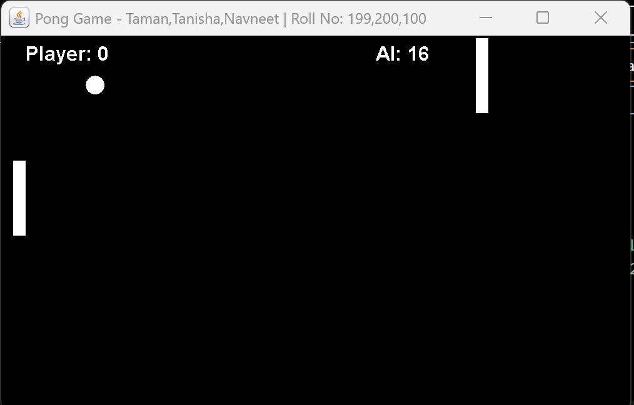
Results and Conclusion
Reinforced understanding of GUI programming, event handling, and animation loops.
The game is modular and can be easily extended with features like sound, levels, or multiplayer.
A great foundation for exploring more advanced game development in Java.
The project demonstrates how core Java concepts can be applied to build interactive games.

Slide 12
References
Java Swing & AWT Documentation – https://docs.oracle.com/javase/tutorial/uiswing/
Oracle Java SE API – https://docs.oracle.com/en/java/javase/
Pong Game History – Atari Inc., 1972
Java Game Development Tutorials – GeeksforGeeks, TutorialsPoint, YouTube
IDEs Used – Eclipse / IntelliJ IDEA (optional for development)

Slide 13
Thank You

Slide 14
Feedback from the Panel
The panel wants the team to :

